Slide 1


KUCH BANAO ! KUCH BANO!

Slide 2

Design Thinking Project
C²
Mohamed Adnan Shaikh - 07
Ahmed Tufail - 09
Ahmed Memon - 10
Ammar Khan - 17
Bilal Shaikh - 29
Kail Fernando - 48
Play Forward:
Empowering the Next Generation of Athletes

Slide 3
Agenda
List of Topics Covered in the Presentation
Empathy
Problem Identification and Definition
User Persona
Research Methods Used
Brain Storming
Empathy Map
Journey Map
Internet Research
Survey
Insights
Pain Points
Goals
Behavior
Solution Based on Insights
Ideation
Research
Ideation
Final Solution
Prototype
Features & Function

Slide 4
Introduction
Brief Overview of the Project
Addressing challenges faced by sportspersons in various sports.
Lack of access to facilities, limiting the ability to develop skills.
Purpose
Empower sportspersons in metropolitan and rural areas.
Create a supportive ecosystem for skill development, talent nurturing and equitable access to resources, enabling athletes to reach their full potential.
Goals
Provide access to resources
Promote talent development
Create competitive platforms to promote athletic growth

Slide 5
Problem Statement
Who has the problem: Sportspersons in metropolitan cities and rural areas, particularly those in basketball and swimming.
What is the problem: Limited opportunities due to inadequate facilities, lack of professional guidance, and a lack of organized events.
Where/When the problem occurs: Across urban and rural areas, consistently affecting training and competitive participation.
Why it matters: Enhancing this will foster athletic skill development, promote equitable opportunities, and drive the growth of a robust sports culture. This, in turn, will help India excel on the global stage, especially in the Olympics.

Slide 6
Personas
Persona 1
Persona 2
Age : 17
Occupation : Student
Location : Mumbai
Background : Haziq Siddique is a college student. He wants to have some competition in swimming.
Goals : His goal is to play more competition in swimming.
Age: 21
Occupation: Student
Location : Mumbai
Background : Ali Ansari is a student at T.Y. at Maharashtra College. He finds very difficult to find a platform where he can enhance his basketball skills and showcase his skills.
Goals : His goal is to play national level and represent Indian National Basketball team at Olympics.

Slide 7
Research Method Used
1. Empathy Map
2. Journey Map
3. Survey
4. Internet Research
5. Insights

Slide 8
Empathy Map : Persona 1
What He Says : “I want more opportunities to compete in swimming.”
“I need to find more competitions that match my skill level.”
“It’s hard to get access to proper training and events around here.”
What He Thinks : “Will I ever get the chance to compete at a higher level?”
“I need to improve my skills, but I don’t have enough guidance.”
“How do I build connections with other swimmers or coaches?”
What He Does :“Searches online for local competitions or events to participate in.”
“Participates in informal or college-level competitions.”
What He Feels : “Frustration over limited access to competitive opportunities.”
“Hopeful when finding new events or potential training opportunities.”
“Determined to continue improving despite limited resources.”
What He Sees: “Few competitive swimming events in Mumbai, especially for amateur swimmers.”
“Lack of proper facilities or advanced coaches at my end.”
“Other swimmers with better access to resources and opportunities.”

Slide 9
Empathy Map : Persona 2
What He Says : “I wish I had better facilities to train.”
“I need a mentor to guide me.”
“There aren’t enough competitions to showcase my skills.”
What He Thinks : “Am I making enough progress compared to others?”
“Will I ever get the opportunity to compete at a higher level?”
“How can I improve without proper training resources?”
What He Does :“Searches online for tutorials, training programs, and events.”
“Participates in local sports activities when available.”
“Connects with peers or local clubs to find opportunities.”
What He Feels : “Frustration for lack of resources and opportunities.”
“Hope when discovering new events will be easily possible.”
“Isolation when unable to find support or recognition.”
What He Sees : “Limited infrastructure.”
“Few organized sports events or competitions.”
“Opportunities being more accessible to privileged athletes.”

Slide 10
User Journey Map
Stage 1: Awareness
Touchpoints: Facilities[Basketball courts, swimming pools, local sports clubs], Events[Local, regional, and national competitions], Support Systems[Training programs, financial aid (largely absent)].Platforms[Social media and community platforms for awareness and learning].
Activities: Playing sports[Basketball, Swimming], Participating in events[Rarely or occasionally], Coaching[Professional (few) and unprofessional (majority)], Workouts[Minimal awareness and adoption of sport-specific routines].
Thoughts: Facilities need improvement, particularly accessibility and quality. Limited awareness about structured training programs and proper routines. High costs and overpopulation in facilities are significant barriers. Strong desire for professional training and organized sports events.
Emotions: Positive[Passion for sports, hope for better opportunities] .Negative[Frustration with current facilities and lack of support]. Aspirational[Eagerness for community-building and improved infrastructure].

Slide 11
User Journey Map
Stage 2: Consideration
Touchpoints: Community engagement, Professional guidance, Event & Competitions and Facility Access.
Activities: Researching different options which provide the same opportunities, Scheduling meeting some professional sportsperson and reading reviews & suggestions from consumer.
Thoughts: Which ideation will be best for the consumer perspective how will this be other be different from competitors.
Emotions: Overwhelmed, Excited & Hope.

Slide 12
User Journey Map
Stage 3: Decision
Touchpoints: Community engagement, Professional Guidance, Event Management & Facility discovery.
Activities: Build a community platform, Provide Professional guidance, Organise regular sports, enhance facilities and raise awareness
Thoughts: Facilities Improvement, affordable & professional coaching, awareness about sports and regular arrangement of sports.
Emotions: Excitement, Frustration, Hope and Inspiration.

Slide 13
Survey
Name: Haziq, Adeen, Muzil, Ali, Numan and Adnan.
Age: 17(16.7%), 18(16.7%), 20(16.7%), 21(33.3%) and 25(16.7%).
Gender: Male(100%).
City: Mumbai(100%).
Sports: Basketball(50%) and Swimming(50%).
1. How would you rate the availability of sports facilities in your area?: Very good(0%), Good(0%), Neutal(50%), Bad(33.3%) and Very Bad(16.7%).
2. Are those adequate facilities for your chosen sports(Basketball courts, swimming pool)? : Yes(33.3%) and No(66.7%).
3. What kind of coaching or training do receive currently? : Professional(66.7%) and Unprofessional(33.3%).
4. How often do you get the opportunities to participate in sports events or competition? Rarely(33.3%), Occasionally(33.3%) and Never(33.3%).
5. Are there Local, Regional or National events available for your sports? : Yes(50%) and No(50%).

Slide 14
6. Do you feel that there is enough awareness about your sport in your area? : Yes(88.3%) and No(16.7%).
7. Do you receive any kind of support (financial, training) from local authorities or organization? : Yes(0%) and No(100%).
8. Are your aware of the training programs and specialize specific workouts that are recommended for your sport? : Yes(83.3%) and No(16.7%).
9. If yes, How did you learn about them? : Social Media, Sports Club.
10. Do you follow specific workout routine? Yes(0%) and No(100%).
11. If no, why are you not following the routine? : Specifically, people were not aware about the training program.
12. What improvements would you suggest for the sports facilities in your area? : Spread awareness, Professional training, More events and competition and More availability of facilities.
13. What type of events or competition would you like to see more of? : Local(50%), Regional(50%) and National(0%).
14. Any additional comment or suggestion : Prices are very high of sports club, Need more events to participate, More awareness about sports, No specific platform, Create a league like IPL and ISL.

Slide 15
Internet Research
Unlocking India's $130B Sports Market Potential(Deloitte Report)
Key Insights:
India’s sports market is valued at $130 billion, driven by grassroots development, infrastructure expansion, and fan engagement.
Opportunities for sports apps include talent discovery, interactive fan communities, and real-time updates.
Leverage technology like AI and analytics to revolutionize user experiences and maximize engagement.
(Source: Deloitte ThinkSports Report)
https://www2.deloitte.com/in/en/pages/technology-media-and-telecommunications/articles/thinksports-unlocking-indias-130bn-sports-potential.html?id=in:2sm:null:4dcom_share:5awa:6dcom:technology,_media_&_telecommunications=

Slide 16
Insights
Pain Points:
Availability and adequacy of facilities are limited
Unable to access to professional training
Lack of events to participate
Inadequate support & awareness
No proper platform where all the facilities are available in one place
Goals:
Enhance facilities
Better coaching
Increased awareness
More frequent events to participate
Support from authorities
Behavior:
Aspiring for better opportunities
Seeking awareness & guidance
Frustration over resource gap
Barriers affecting consistency

Slide 17
Solution based on Insights
1. Insight: Need for Better Community Interaction and Support.
Solution: To create a platform that fosters a strong, active community where members can share experiences, ask questions, and connect with like-minded individuals. This encourages collaboration, peer support, and knowledge exchange.
2. Insight: Professional Guidance is Often Limited or Hard to Access.
Solution: To create a platform that offers expert-led videos, tutorials, and workshops, giving users direct access to professional guidance at their convenience. The content can cover industry trends, career advice, or skill-building opportunities.
3. Insight: Difficulty in Finding Opportunities and Events.
Solution: To create a platform that organizes and host events and competitions for overall development of athletes.
4. Insight: Desire for Continuous Learning and Development.
Solution: By integrating learning modules, online courses, and live Q&A sessions with professionals, users are provided with continuous learning opportunities that can help them upskill and stay ahead in their fields.
5. Insight: Barriers in Building Long-Term Connections.
Solution: To create a platform that enables uses features like discussion forums, mentorship matching, and interest-based groups to help users build and nurture lasting connections with others in their industry.

Slide 18
Research
Existing Solutions-Competitors : YMCA, Nike Training App & Small Clubs.
Survey findings : We have found that there is a need for a solution, where the Sportsperson’s will be able to get professional training and there is a need for organising events.
Research findings : We have found that there are no such solution’s that provides Sportsperson's an expert professional training. There are many regional events but there are no many such state and national level events.

Slide 19
Ideation
Brainstorming Techniques Used : Mind Mapping & Brain Writing.
Key Ideas Generated: Develop an application, Partnership with small clubs & Hybrid model of app and club.
How Ideas Were Prioritized
Goals : Enhance facilities, Proper professional guidance, organize events and competition, foster community engagement.
Pain Points : Lack of proper facilities, Inadequate professional guidance, Limited competitive opportunities.

Slide 20
Ideation:
1. Develop an App
Platform for Community Engagement
1. Create different communities for each sport where athletes can discuss their experiences, share tips, and support each other.
Professional Guidance
1. Offer access to professional training programs, workout routines, and dietary plans tailored to different sports and skill levels.
2. Provide video tutorials and expert advice from coaches and trainers.
Organize Events
1. Schedule regular events and competitions in various locations to encourage participation.
2. Facilitate matches and meets where athletes can compete and interact with peers from different areas.

Slide 21
Ideation:
2. Collaboration with Small Clubs
Partnerships
Form partnerships with local sports clubs to provide professional guidance and resources. Use these clubs as hubs for training, events, and community engagement.
Professional Guidance
Deploy certified coaches to these clubs to offer training programs, workout routines, and dietary plans. Conduct regular workshops and clinics to provide expert advice and improve athletes' skills.
Event Organization
Organize local competitions and events through these clubs to encourage participation and provide competitive experience. Facilitate inter-club matches to help athletes gain exposure and build confidence.

Slide 22
Ideation:
3. Hybrid Model of App & Clubs
App-Based Platform:
Utilize the app to create online communities for each sport where athletes can discuss, share experiences, and access resources.
Offer virtual training programs, workout routines, and dietary plans through the app, including video tutorials and expert advice.
Local Club Collaboration:
Partner with small local clubs to provide in-person training sessions and workshops conducted by certified coaches.
Provide clubs with access to training materials, equipment, and facilities to enhance on-ground training.
Event Organization:
Organize both virtual competitions (e.g., skill challenges, online tournaments) and physical events (e.g., local matches, inter-club competitions) to encourage participation.
Use the app to coordinate event schedules, registrations, and announcements, ensuring seamless integration between virtual and in-person events.
Progress Tracking:
Allow athletes to track their progress, set goals, and receive feedback through the app, complementing the in-person guidance they receive at clubs.
Provide regular updates and insights from both virtual and physical training sessions to keep athletes motivated and informed.

Slide 23
Final Solution
Final Solution:- Create an Application.
Description of the Final Design:- The app will be having a platform where the users will be able to have a community to discuss, keep a track of what happening around the world about sports, participate in events and have a professional training for the particular sports.

Slide 24
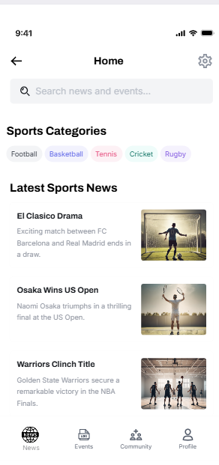
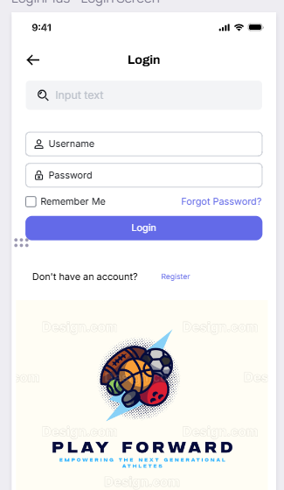
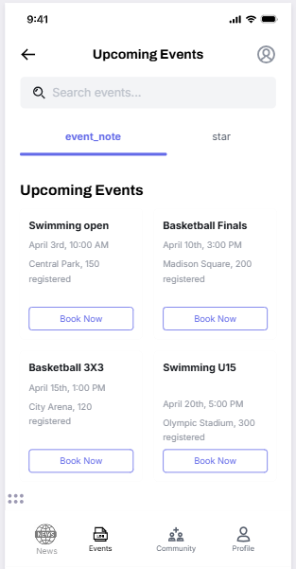
Prototyping
User Interface

Slide 25
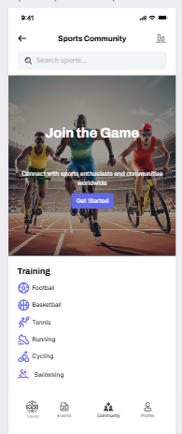
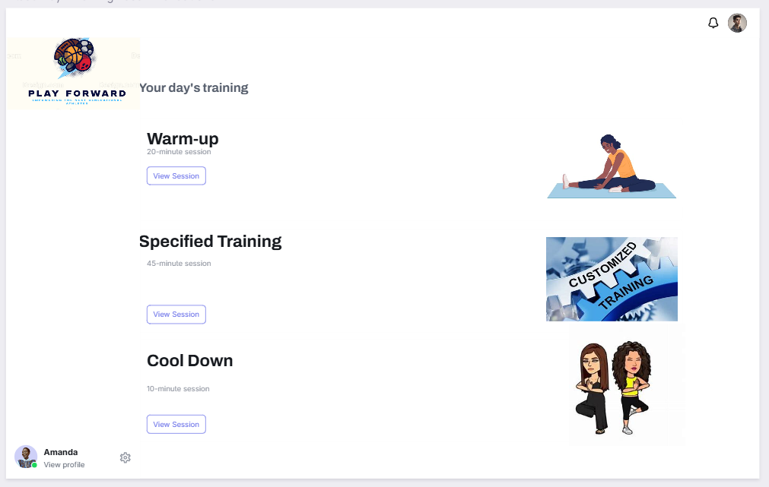
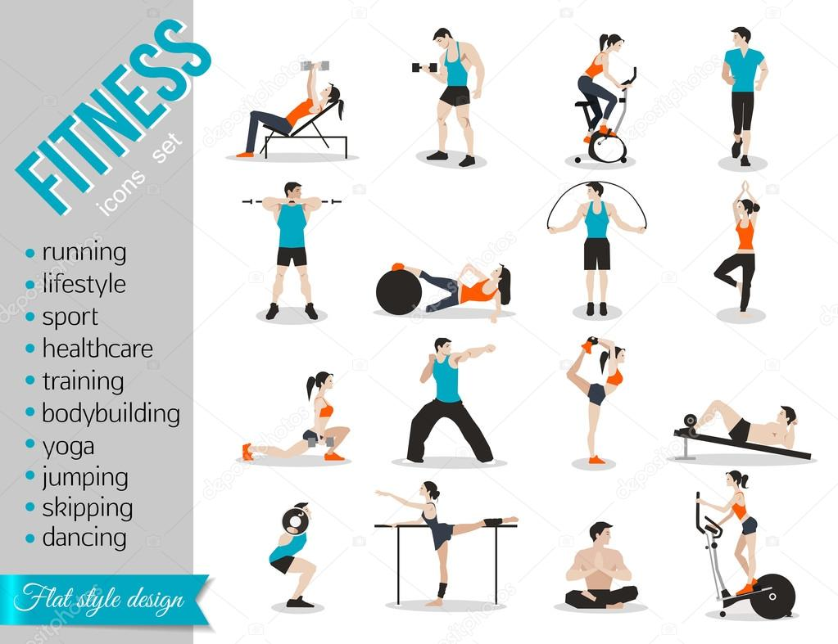
User Interface

Slide 26
Features & Function
Features:
1. Create a user profile with personal and professional information.
Create a Community for discussion of various topics.
To give professional guidance and training.
To organise events and have a overall growth.
Have a group chat for events participates or community group.
Feedback and support for users to share experiences.
Functions:
Push Notification: Alerts for new messages, events and important updates.
Integration: compatibility with other popular tools and platforms (e.g. Calander apps).
Analytics: Tools for tracking user engagement, popular content and event attendance.

Slide 27
Thank You

